Slide 1

W4111 – 02: Introduction to Databases
Lecture 7: Wrapping Up Relational, SQL, ER (For Now)
Donald F. Ferguson dff9@Columbia.edu
TRANSCENDING DISCIPLINES, TRANSFORMING LIVES

Slide 2

Contents
2 | W4111_02_S20: Introduction to Databases – Lecture 7

Slide 3
Contents
ER Patterns and Realization
Complex/Compound Attributes; Derived Attributes
Weak Entities
Ternary (and more Complex) Relationships
Aggregation
Miscellaneous Design Issues.
Advanced SQL
Recursion
Views and Security
3 | W4111_02_S20: Introduction to Databases -- Lecture 7

Slide 4
ER Modeling and Realization
4 | W4111_02_S20: Introduction to Databases – Lecture 7

Slide 5
Complex Attributes
Relational Model
5 | W4111_02_S20: Introduction to Databases – Lecture 6

Slide 6
Complex Attributes
Attribute types:
Simple and composite attributes.
Single-valued and multivalued attributes
Example: multivalued attribute: phone_numbers
Derived attributes
Can be computed from other attributes
Example: age, given date_of_birth
Domain – the set of permitted values for each attribute

Slide 7
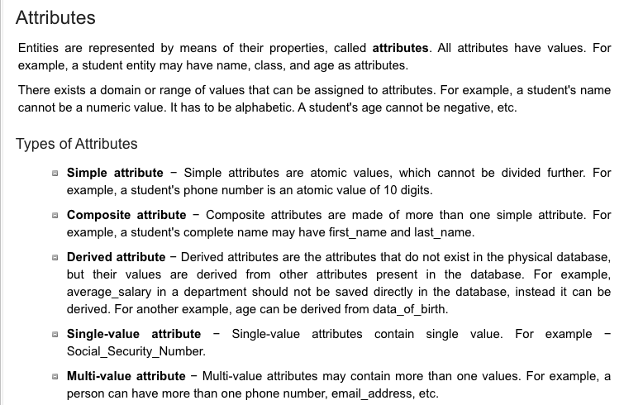
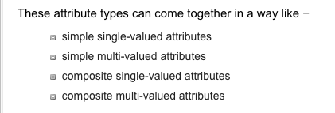
Attributes (https://www.tutorialspoint.com/dbms/er_model_basic_concepts.htm)
7 | W4111_02_S20: Introduction to Databases -- Lecture 7

Slide 8
Composite Attributes
Composite attributes allow us to divided attributes into subparts (other attributes).

Slide 9
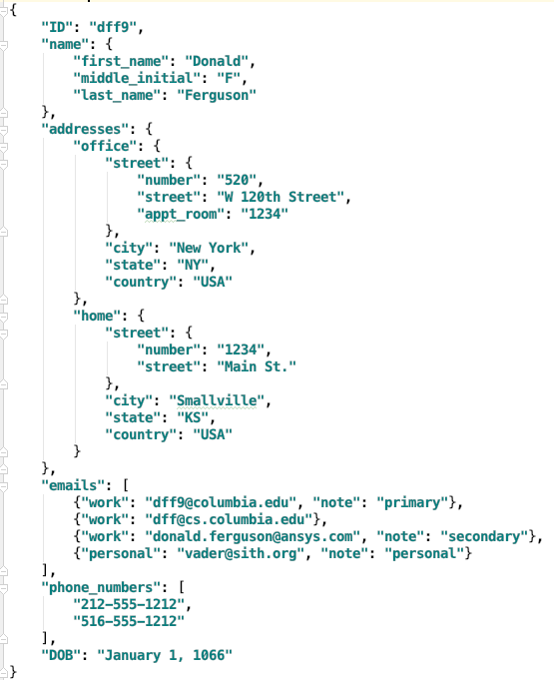
Representing Complex Attributes in ER Diagram
Composite (Map)
Nested Composite (Map)
Multivalued of Composites (Map)
Multi-valued
Bad Format

Slide 10
First Normal Form
Domain is atomic if its elements are considered to be indivisible units
Examples of non-atomic domains:
Set of names, composite attributes
Identification numbers like CS101 that can be broken up into parts
A relational schema R is in first normal form if the domains of all attributes of R are atomic
Non-atomic values complicate storage and encourage redundant (repeated) storage of data
Example: Set of accounts stored with each customer, and set of owners stored with each account
We assume all relations are in first normal form (and revisit this in Chapter 22: Object Based Databases)
(DFF) Normalization
“[Relational] Database normalization is the process of structuring a relational database in accordance with a series of so-called normal forms in order to reduce data redundancy and improve data integrity.” (https://en.wikipedia.org/wiki/Database_normalization)
Normalization is a formal, methodology for think about what makes a “good relational schema.”

Slide 11
First Normal Form (Cont.)
Atomicity is actually a property of how the elements of the domain are used.
Example: Strings would normally be considered indivisible
Suppose that students are given roll numbers which are strings of the form CS0012 or EE1127
If the first two characters are extracted to find the department, the domain of roll numbers is not atomic.
Doing so is a bad idea: leads to encoding of information in application program rather than in the database.

Slide 12
First Normal Form (Cont.)
Atomicity is actually a property of how the elements of the domain are used.
Example: Strings would normally be considered indivisible
Suppose that students are given roll numbers which are strings of the form CS0012 or EE1127
If the first two characters are extracted to find the department, the domain of roll numbers is not atomic.
Doing so is a bad idea: leads to encoding of information in application program rather than in the database.
There are several issues and problems that not applying 1NF can cause.
Two of the most significant are:
Difficulty implementing integrity constraints.
Poor performance due to inability to use indexes.

Slide 13
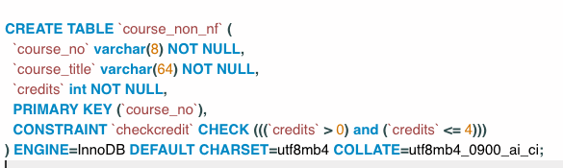
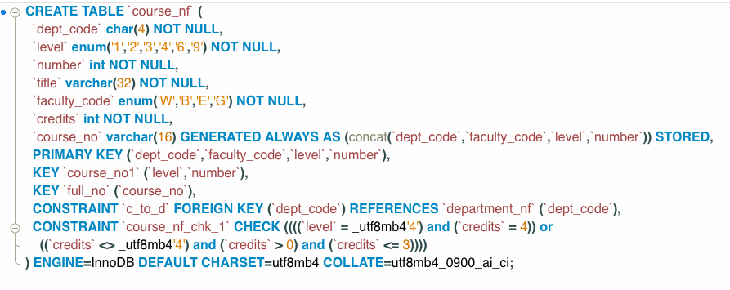
1NF and Integrity
Consider a course number like “COMSW4111”
Strings/VARCHAR is usually an atomic domain.
But is not in this case.
Representing the course number as a string
Precludes integrity constrains on the department code, faculty code and level.
Precludes adding an index on elements of the number like ‘4111.’
We will see why in the next module.
If we want to treat the composite attribute as a string, we can
Generate the column.
If it is a stored, generate column, we can also index it.
13 | W4111_02_S20: Introduction to Databases -- Lecture 7

Slide 14
How Not to Model in Relational
CREATE TABLE `W4111Examples`.`bad_table` (
`id` VARCHAR(32) NULL,
`name` VARCHAR(256) NULL,
`address1` VARCHAR(256) NULL,
`address2` VARCHAR(256) NULL,
`emails` VARCHAR(256) NULL,
`phone_work` VARCHAR(45) NULL,
`phone_other` VARCHAR(45) NULL);
Approaches like this create several problems:
Query on things like last_name or country.
Integrity: emails are unique
Insight:
Finding people in the same zip code.
Which people have business emails?
Difficult to index for efficiency.
We will study database models that support and recommend “document” or “object” like approaches.
14 | W4111_02_S20: Introduction to Databases -- Lecture 7

Slide 15
How Not to Model in Relational
CREATE TABLE `W4111Examples`.`bad_table` (
`id` VARCHAR(32) NULL,
`name` VARCHAR(256) NULL,
`address1` VARCHAR(256) NULL,
`address2` VARCHAR(256) NULL,
`emails` VARCHAR(256) NULL,
`phone_work` VARCHAR(45) NULL,
`phone_other` VARCHAR(45) NULL);
So how do you do this in the relational model?
Approaches like this create several problems:
Query on things like last_name or country.
Integrity: emails are unique
Insight:
Finding people in the same zip code.
Which people have business emails?
Difficult to index for efficiency.
We will study database models that support and recommend “document” or “object” like approaches.
15 | W4111_02_S20: Introduction to Databases -- Lecture 7

Slide 16
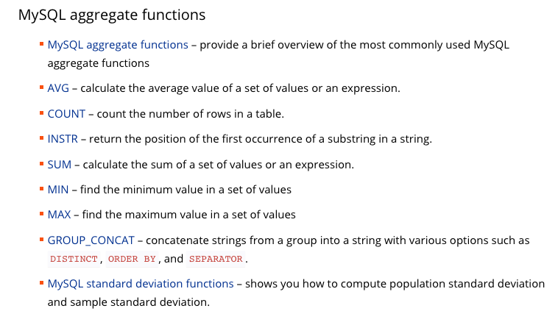
Generated Columns, Column Types and Functions
Relational Databases have built in functions for many types.
From https://www.mysqltutorial.org/mysql-functions.aspx for MySQL. List is complete.
Other RDBs have similar sets of functions.
16 | W4111_02_S20: Introduction to Databases -- Lecture 7

Slide 17
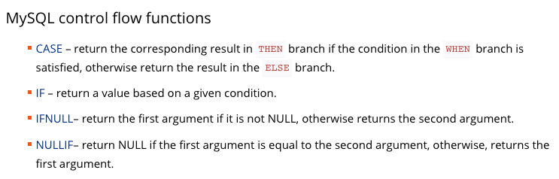
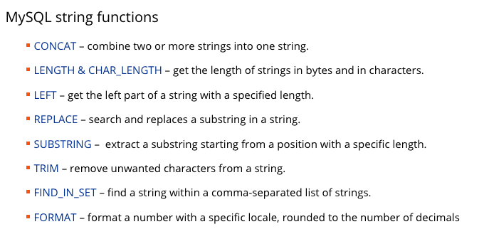
Generated Columns, Column Types and Functions
Relational Databases have built in functions for many types.
From https://www.mysqltutorial.org/mysql-functions.aspx for MySQL. List is complete.
Other RDBs have similar sets of functions.
17 | W4111_02_S20: Introduction to Databases -- Lecture 7

Slide 18
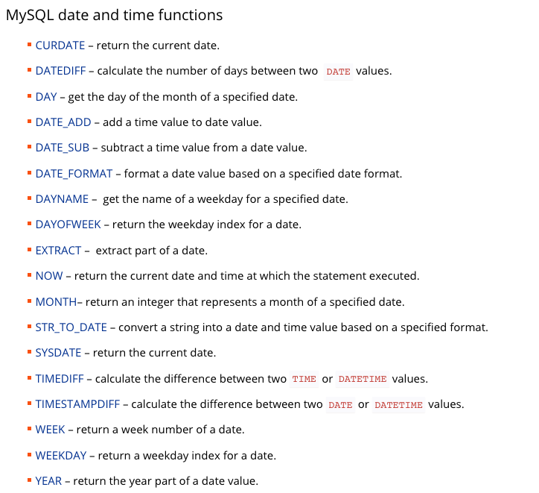
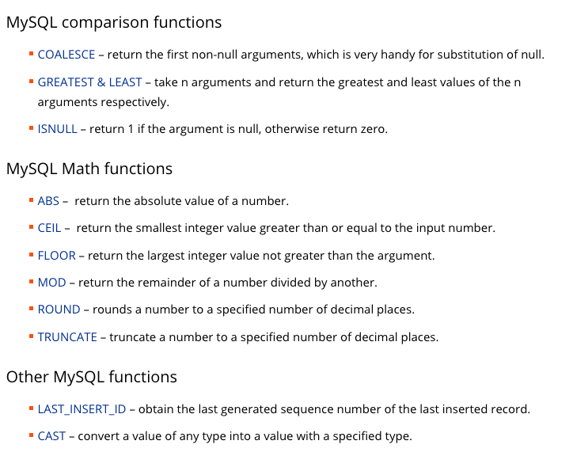
Generated Columns, Column Types and Functions
18 | W4111_02_S20: Introduction to Databases -- Lecture 7

Slide 19
Some Examples
Switch to Notebook
19 | W4111_02_S20: Introduction to Databases -- Lecture 7

Slide 20
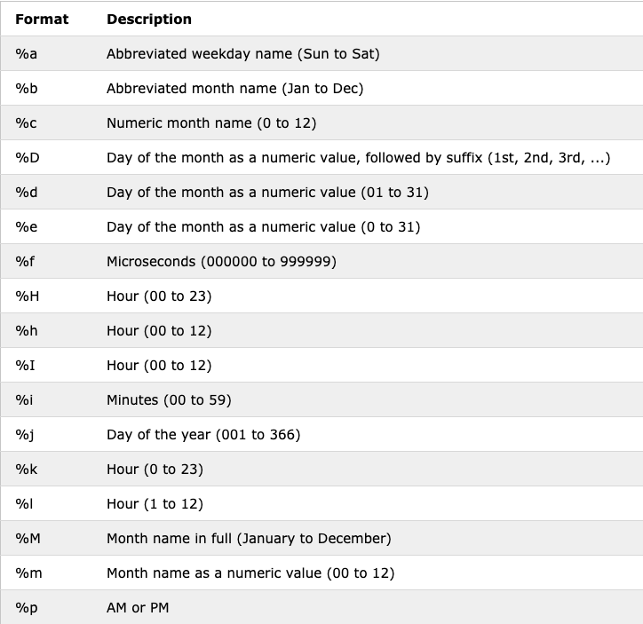
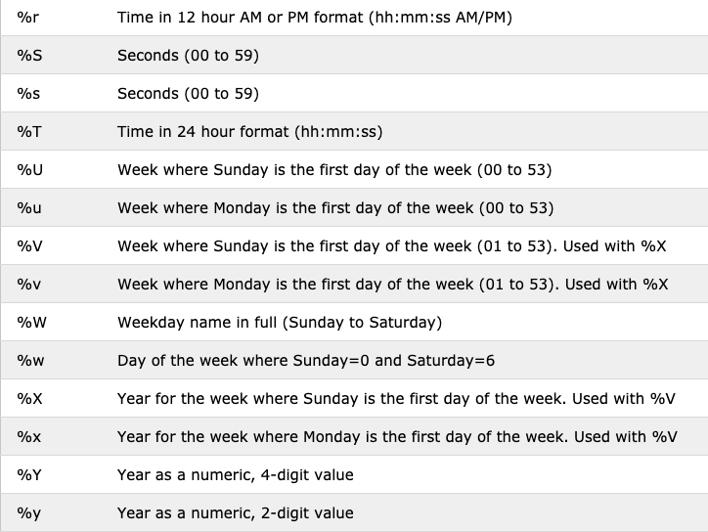
Date Formatting and Parsing
20 | W4111_02_S20: Introduction to Databases -- Lecture 7

Slide 21
Handling Compound/Composite Attributes
Let’s use a simpler test case.
Analysis:
Name is clear, and we should decompose into three columns.
Some aspects of Address are clear:
We need to decompose into individual columns, e.g. street, town, state, country.
The level of decomposition is a judgement call, e.g. do we separate street into (no, name)?
There is a fundamental design question/judgment decision:
Is the Address a property of a Person?
Or, is a Person related to an instance of an Address entity?
We need to determine how to handle country and state, which have values that come from a fixed domain.
Email seems relatively simple, if there is only one.
Phone seems relatively simple if there is one. We need to determine if compound:
Country code
Telephone number
21 | W4111_02_S20: Introduction to Databases -- Lecture 7

Slide 22
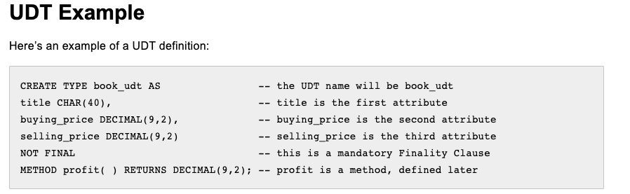
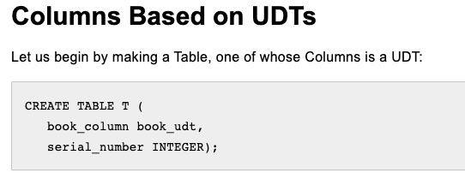
User-Defined Types
create type construct in SQL creates user-defined type
create type Dollars as numeric (12,2) final
Example:
create table department (dept_name varchar (20), building varchar (15), budget Dollars);
<dff>
Not sure how common using UDT is. I almost never see it.
Support across various RDBMS products is inconsistent.
https://crate.io/docs/sql-99/en/latest/chapters/27.html#udt-example

Slide 23
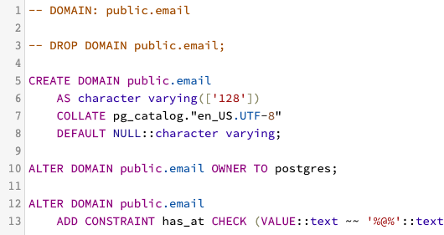
Domains
create domain construct in SQL-92 creates user-defined domain types
create domain person_name char(20) not null
Types and domains are similar. Domains can have constraints, such as not null, specified on them.
Example:
create domain degree_level varchar(10) constraint degree_level_test check (value in ('Bachelors', 'Masters', 'Doctorate'));
This is the PostgreSQL of saying the value of an an element in a email domain must be
LIKE “%@%”
Again, I am not sure how common this is or how consistent the support is.

Slide 24
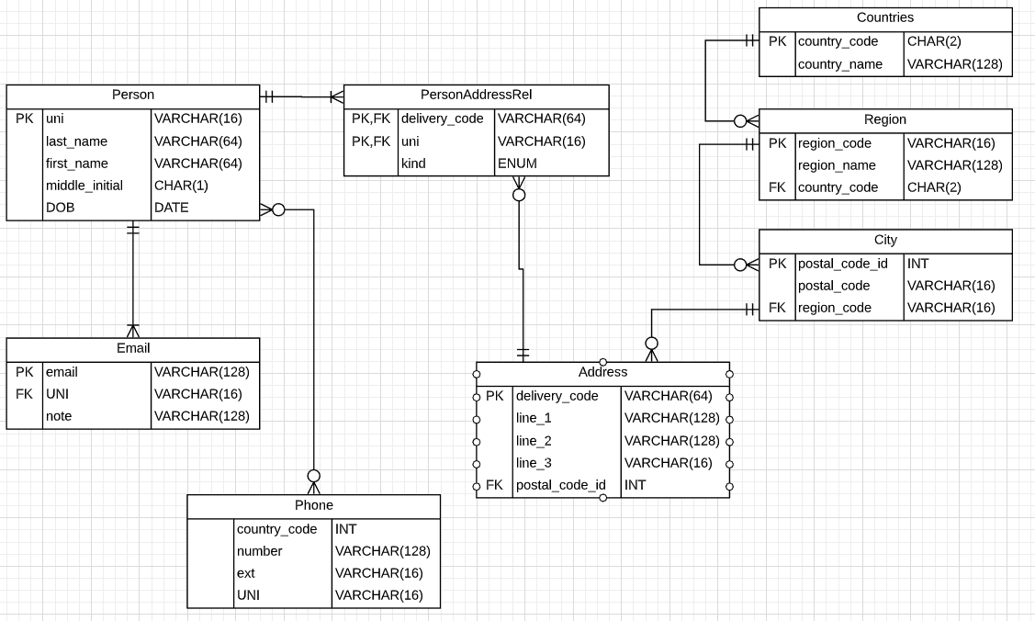
Back to Our Example – An Initial Pass
This is a first pass and has some errors.
Would not be sure until encountered some data.
There are a couple of issues that I know about.
24 | W4111_02_S20: Introduction to Databases -- Lecture 7

Slide 25
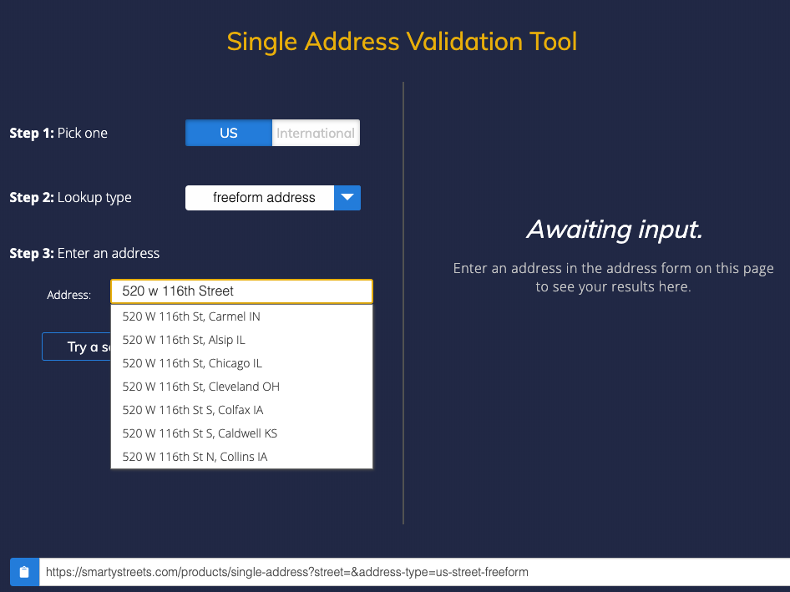
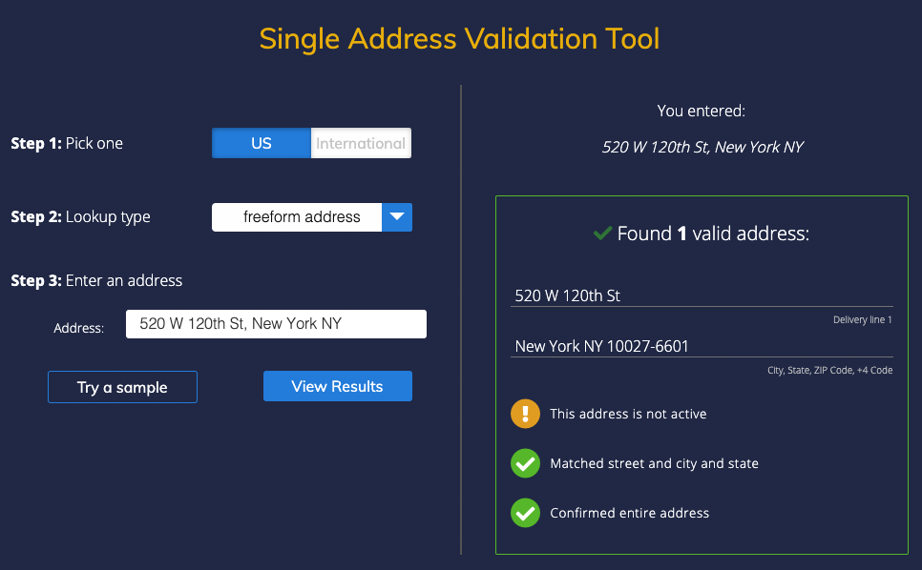
Addresses can be Surprisingly Complicated
25 | W4111_02_S20: Introduction to Databases -- Lecture 7

Slide 26
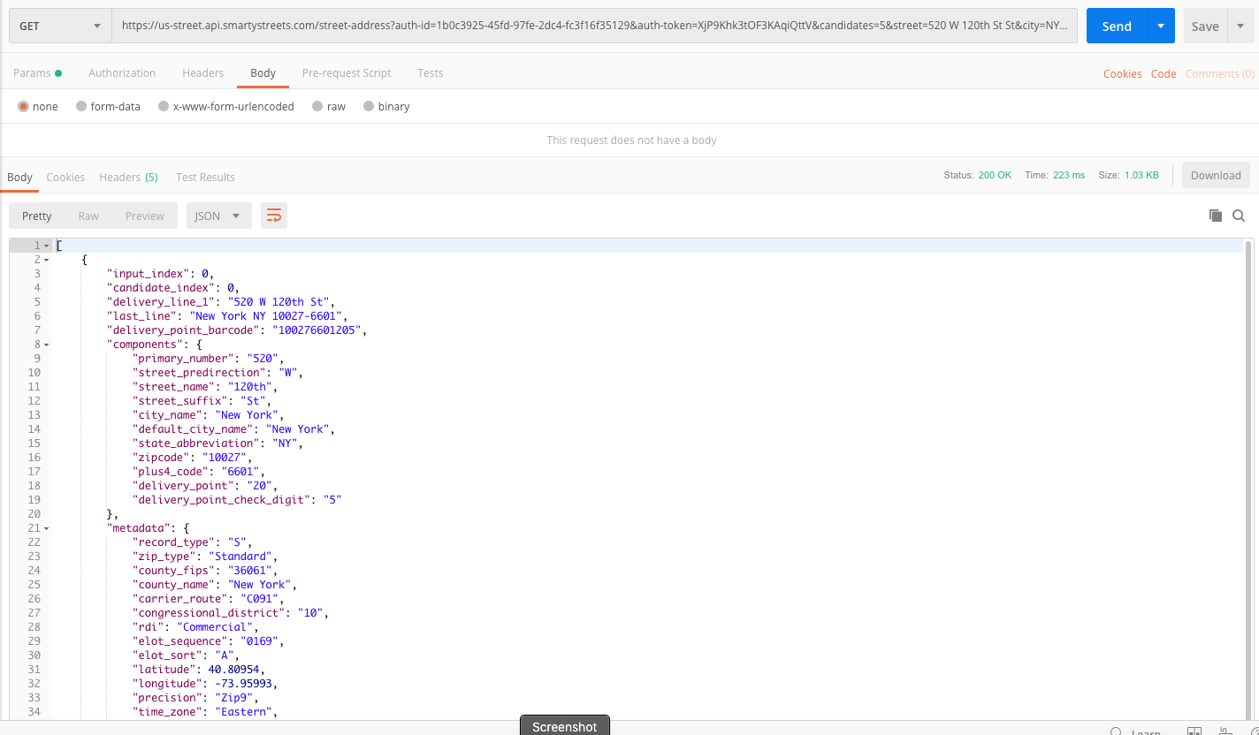
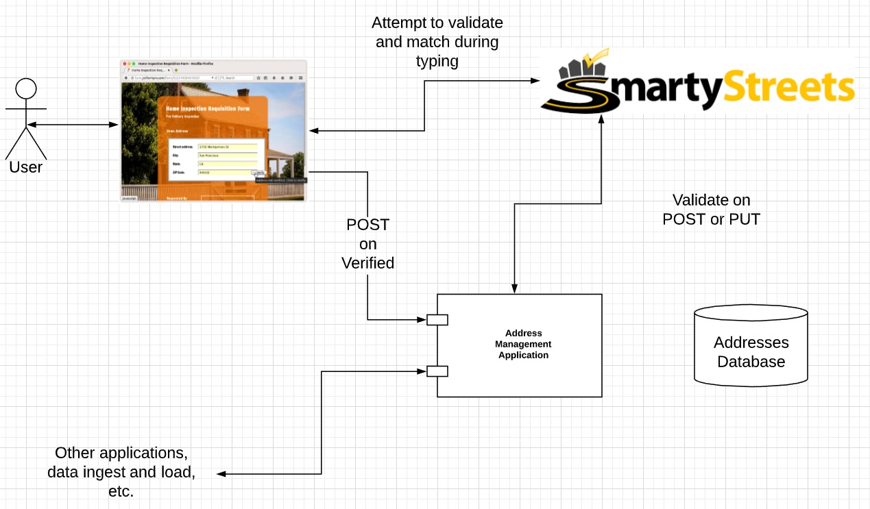
Addresses can be Surprisingly Complicated
26 | W4111_02_S20: Introduction to Databases -- Lecture 7

Slide 27
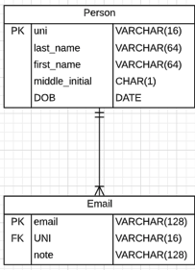
Back to Our Example – An Initial Pass
We have taken a quick, simple look at:
Compound/composite attributes and mapping to the relational model.
Compound attributes as:
Multiple columns in an entity.
A separate table/entity with multiple columns.
Multi-valued attributes as related entities:
Many-to-Many
One-to-Many
Properties of the relationship.
We are not going to implement the tables/schema right now. You should be able to implement most of the diagram, with some exceptions.
There were some interesting constraints that we glossed over, e.g.
You cannot make a person without at least one Email.
Every email has exactly one Person.
What do you make 1st, the chicken or the egg?
Also, we have not considered at least one.
This is a first pass and has some errors.
Would not be sure until encountered some data.
There are a couple of issues that I know about.
27 | W4111_02_S20: Introduction to Databases -- Lecture 7

Slide 28
Weak Entity
Relational Model
28 | W4111_02_S20: Introduction to Databases – Lecture 5

Slide 29
Weak Entity Sets
Consider a section entity, which is uniquely identified by a course_id, semester, year, and sec_id.
Clearly, section entities are related to course entities. Suppose we create a relationship set sec_course between entity sets section and course.
Note that the information in sec_course is redundant, since section already has an attribute course_id, which identifies the course with which the section is related.
One option to deal with this redundancy is to get rid of the relationship sec_course; however, by doing so the relationship between section and course becomes implicit in an attribute, which is not desirable.
“In a relational database, a weak entity is an entity that cannot be uniquely identified by its attributes alone; therefore, it must use a foreign key in conjunction with its attributes to create a primary key. The foreign key is typically a primary key of an entity it is related to.” (https://en.wikipedia.org/wiki/Weak_entity)
One way to think about this is that a section does not “require” a course or “depend” on a course. The section is somehow inside of or part of a course.

Slide 30
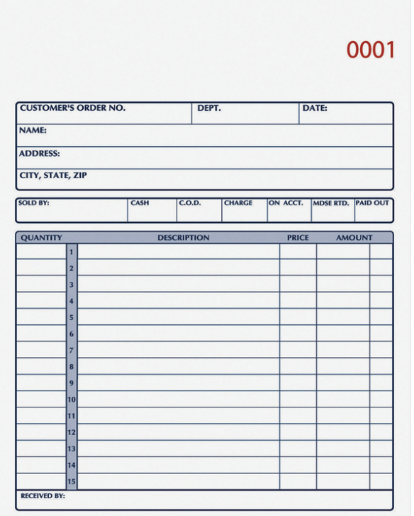
Weak Entity – Consider and Order Form
The order has attributes that are part of the order:
Date
Amount
Priority
etc.
Dependency (Foreign Key Constraint) on other entities:
Customer
Product
Address
But has these other weird things that
Repeat
Have attributes
Are sort of “inside” the order
These are weak entities.
30 | W4111_02_S20: Introduction to Databases -- Lecture 7

Slide 31
Weak Entity Sets (Cont.)
An alternative way to deal with this redundancy is to not store the attribute course_id in the section entity and to only store the remaining attributes section_id, year, and semester.
However, the entity set section then does not have enough attributes to identify a particular section entity uniquely
To deal with this problem, we treat the relationship sec_course as a special relationship that provides extra information, in this case, the course_id, required to identify section entities uniquely.
A weak entity set is one whose existence is dependent on another entity, called its identifying entity
Instead of associating a primary key with a weak entity, we use the identifying entity, along with extra attributes called discriminator to uniquely identify a weak entity.

Slide 32
Weak Entity Sets (Cont.)
An entity set that is not a weak entity set is termed a strong entity set.
Every weak entity must be associated with an identifying entity; that is, the weak entity set is said to be existence dependent on the identifying entity set.
The identifying entity set is said to own the weak entity set that it identifies.
The relationship associating the weak entity set with the identifying entity set is called the identifying relationship.
Note that the relational schema we eventually create from the entity set section does have the attribute course_id, for reasons that will become clear later, even though we have dropped the attribute course_id from the entity set section.

Slide 33
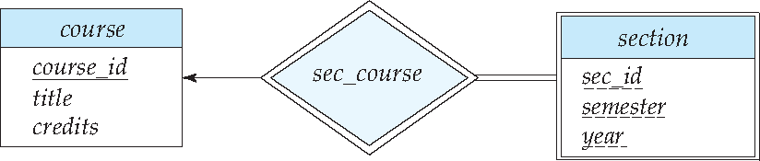
Expressing Weak Entity Sets
In E-R diagrams, a weak entity set is depicted via a double rectangle.
We underline the discriminator of a weak entity set with a dashed line.
The relationship set connecting the weak entity set to the identifying strong entity set is depicted by a double diamond.
Primary key for section – (course_id, sec_id, semester, year)

Slide 34
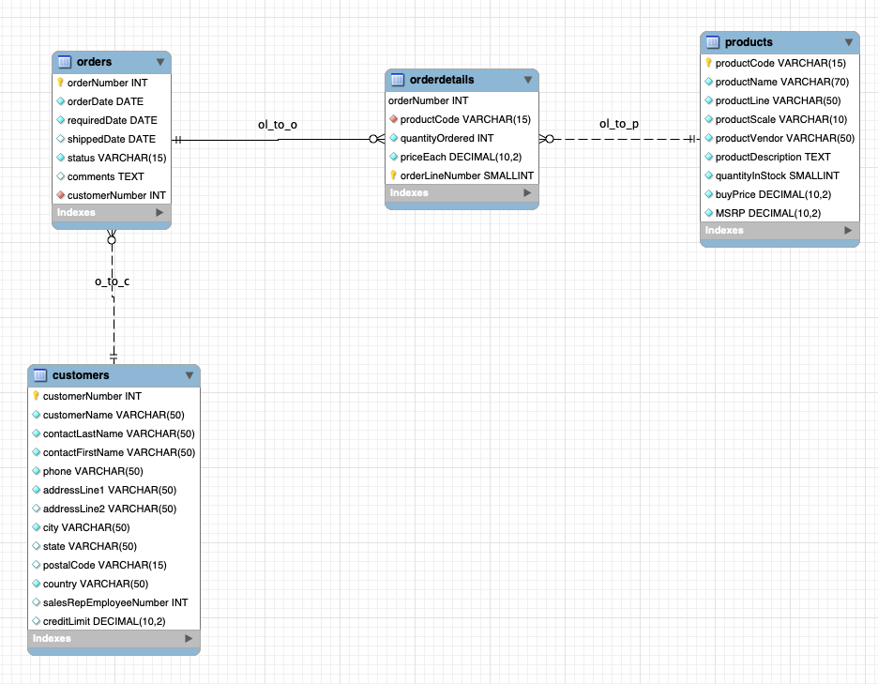
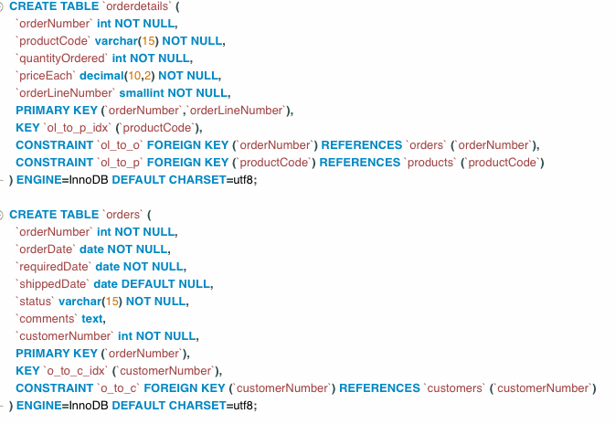
Consider Classicmodels Schema (https://www.mysqltutorial.org/mysql-sample-database.aspx)
A subset of the schema
I put some improvement into the default schema you download.
There are the obvious foreign key constraints:
orderdetails → orders
orderdetails → products
order → customers
Why is one of the lines “dashed?”
MySQL refers to this as an “identifying relationship.”
orderdetails cannot form a primary key without a field from orders.
It is a Weak Entity
orderdetails primary key contains a column of orders primary key.
An order ”owns” or “contains” its orderdetails.
34 | W4111_02_S20: Introduction to Databases -- Lecture 7

Slide 35
Advanced Relationships, Aggregation
Relational Model
35 | W4111_02_S20: Introduction to Databases – Lecture 5

Slide 36
Non-binary Relationship Sets
Most relationship sets are binary
There are occasions when it is more convenient to represent relationships as non-binary.
E-R Diagram with a Ternary Relationship
Note: In SQL/RDB, this requires four tables (relations)
Instructor
Student
Project
“Project Participants”

Slide 37
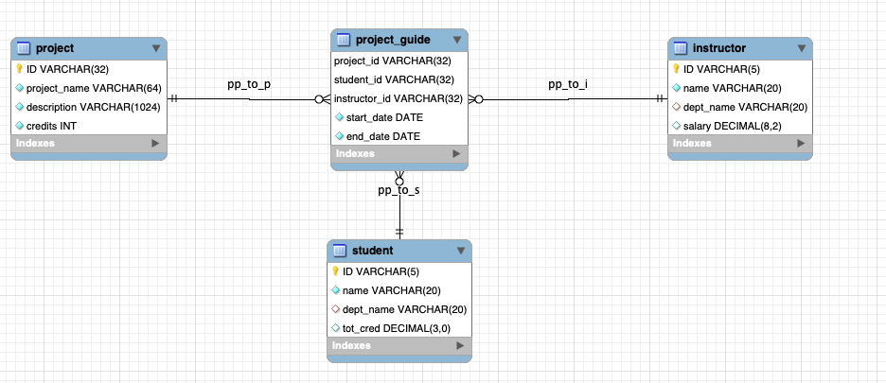
Consider Classicmodels Schema (https://www.mysqltutorial.org/mysql-sample-database.aspx)
Ternary relationship:
3 participants.
Start date and end date.
The semantics of the model may not immediately be clear.
Clearly, the student exists independent of any specific project execution.
The same applies to the instructor.
Why doesn’t the project just reference the instructor and student?
The project is a “definition” of a project.
The project “instance” comes into existence only when an instructor and student decide to work on a “predefined” project for some period of time.
37 | W4111_02_S20: Introduction to Databases -- Lecture 7

Slide 38
Aggregation
Consider the ternary relationship proj_guide, which we saw earlier
Suppose we want to record evaluations of a student by a guide on a project
OK, I admit it. This looks weird.
This is also wrong. eval_for cannot reference any project, student, instructor.
It must reference 3 reference by a proj_guide.

Slide 39
Aggregation (Cont.)
Relationship sets eval_for and proj_guide represent overlapping information
Every eval_for relationship corresponds to a proj_guide relationship
However, some proj_guide relationships may not correspond to any eval_for relationships
So we can’t discard the proj_guide relationship
Eliminate this redundancy via aggregation
Treat relationship as an abstract entity
Allows relationships between relationships
Abstraction of relationship into new entity

Slide 40
Aggregation (Cont.)
Eliminate this redundancy via aggregation without introducing redundancy, the following diagram represents:
A student is guided by a particular instructor on a particular project
A student, instructor, project combination may have an associated evaluation
Notes:
40

Slide 41
Reduction to Relational Schemas
To represent aggregation, create a schema containing
Primary key of the aggregated relationship,
The primary key of the associated entity set
Any descriptive attributes
In our example:
The schema eval_for is:
eval_for (s_ID, project_id, i_ID, evaluation_id)
The schema proj_guide is redundant.
DFF Note: As long as you are OK with evaluation_id being NULL until there is an evaluation.
Enough slides. Let’s build this.

Slide 42
ER Design Issues
Relational Model
42 | W4111_02_S20: Introduction to Databases – Lecture 5

Slide 43
Design Issues

Slide 44
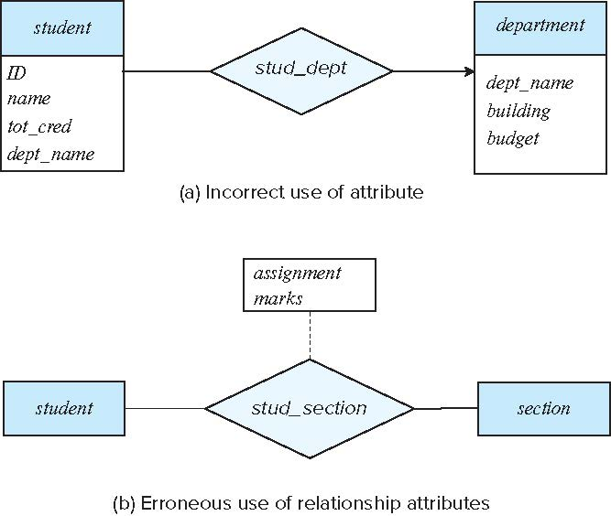
Common Mistakes in E-R Diagrams
Example of erroneous E-R diagrams
Notes:
44

Slide 45
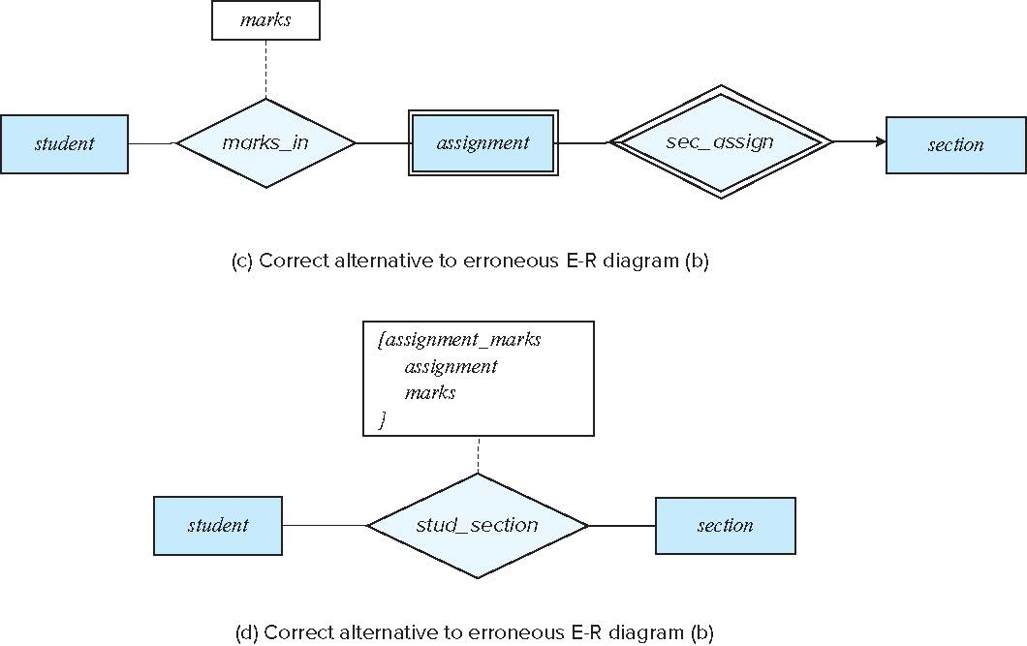
Common Mistakes in E-R Diagrams (Cont.)
Correct versions of the E-R diagram of previous slide
Notes:
45

Slide 46
Entities vs. Attributes
Use of entity sets vs. attributes
Use of phone as an entity allows extra information about phone numbers (plus multiple phone numbers)
Notes:
46

Slide 47
Entities vs. Relationship sets
Use of entity sets vs. relationship sets
Possible guideline is to designate a relationship set to describe
an action that occurs between entities
Placement of relationship attributes
For example, attribute date as attribute of advisor (sic?) or as attribute of student
Notes:
47

Slide 48
Binary Vs. Non-Binary Relationships
Although it is possible to replace any non-binary (n-ary, for n > 2) relationship set by a number of distinct binary relationship sets, a n-ary relationship set shows more clearly that several entities participate in a single relationship.
Some relationships that appear to be non-binary may be better represented using binary relationships
For example, a ternary relationship parents, relating a child to his/her father and mother, is best replaced by two binary relationships, father and mother
Using two binary relationships allows partial information (e.g., only mother being known)
But there are some relationships that are naturally non-binary
Example: proj_guide
Notes:
48

Slide 49
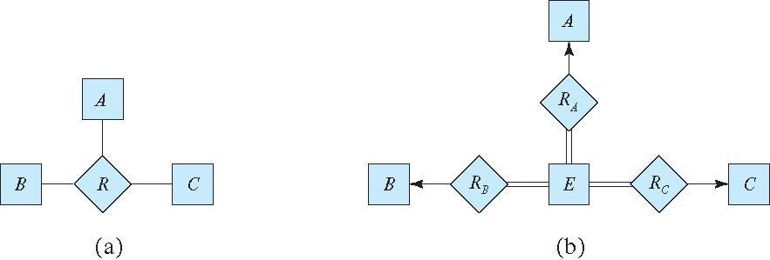
Converting Non-Binary Relationships to Binary Form
In general, any non-binary relationship can be represented using binary relationships by creating an artificial entity set.
Replace R between entity sets A, B and C by an entity set E, and three relationship sets:
1. R_{A}, relating E and A 2. R_{B}, relating E and B 3. R_{C}, relating E and C
Create an identifying attribute for E and add any attributes of R to E
For each relationship (a_{i} , b_{i} , c_{i}) in R, create
1. a new entity e_{i} in the entity set E 2. add (e_{i} , a_{i} ) to R_{A}
3. add (e_{i} , b_{i} ) to R_{B} 4. add (e_{i} , c_{i} ) to R_{C}
Notes:
49

Slide 50
Converting Non-Binary Relationships (Cont.)
Also need to translate constraints
Translating all constraints may not be possible
There may be instances in the translated schema that cannot correspond to any instance of R
Exercise: add constraints to the relationships R_{A}, R_{B} and R_{C} to ensure that a newly created entity corresponds to exactly one entity in each of entity sets A, B and C
We can avoid creating an identifying attribute by making E a weak entity set (described shortly) identified by the three relationship sets
Notes:
50

Slide 51
E-R Design Decisions
The use of an attribute or entity set to represent an object.
Whether a real-world concept is best expressed by an entity set or a relationship set.
The use of a ternary relationship versus a pair of binary relationships.
The use of a strong or weak entity set.
The use of specialization/generalization – contributes to modularity in the design.
The use of aggregation – can treat the aggregate entity set as a single unit without concern for the details of its internal structure.

Slide 52
Advanced SQL
Relational Model
52 | W4111_02_S20: Introduction to Databases – Lecture 5

Slide 53
Recursive Queries
Relational Model
53 | W4111_02_S20: Introduction to Databases – Lecture 5

Slide 54
Recursion in SQL
SQL:1999 permits recursive view definition
Example: find which courses are a prerequisite, whether directly or indirectly, for a specific course with recursive rec_prereq(course_id, prereq_id) as ( select course_id, prereq_id from prereq union select rec_prereq.course_id, prereq.prereq_id, from rec_rereq, prereq where rec_prereq.prereq_id = prereq.course_id ) select ∗ from rec_prereq;
This example view, rec_prereq, is called the transitive closure of the prereq relation
DFF Note: This totally weirds me out. Please do not do this.

Slide 55
The Power of Recursion
Recursive views make it possible to write queries, such as transitive closure queries, that cannot be written without recursion or iteration.
Intuition: Without recursion, a non-recursive non-iterative program can perform only a fixed number of joins of prereq with itself
This can give only a fixed number of levels of managers
Given a fixed non-recursive query, we can construct a database with a greater number of levels of prerequisites on which the query will not work
Alternative: write a procedure to iterate as many times as required
See procedure findAllPrereqs in book

Slide 56
The Power of Recursion
Computing transitive closure using iteration, adding successive tuples to rec_prereq
The next slide shows a prereq relation
Each step of the iterative process constructs an extended version of rec_prereq from its recursive definition.
The final result is called the fixed point of the recursive view definition.
Recursive views are required to be monotonic. That is, if we add tuples to prereq the view rec_prereq contains all of the tuples it contained before, plus possibly more

Slide 57
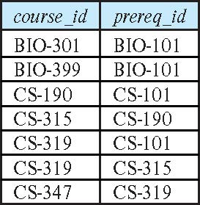
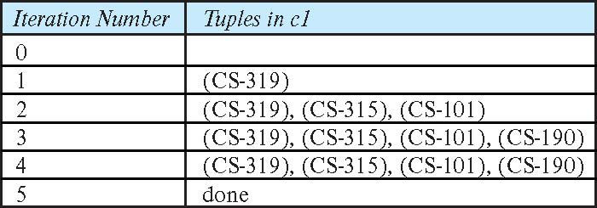
Example of Fixed-Point Computation

Slide 58
Roles
Entity sets of a relationship need not be distinct
Each occurrence of an entity set plays a “role” in the relationship
The labels “course_id” and “prereq_id” are called roles.
DFF Note: The concept of roles applies to all relationships/associations.

Slide 59
View and Security
Relational Model
59 | W4111_02_S20: Introduction to Databases – Lecture 5

Slide 60
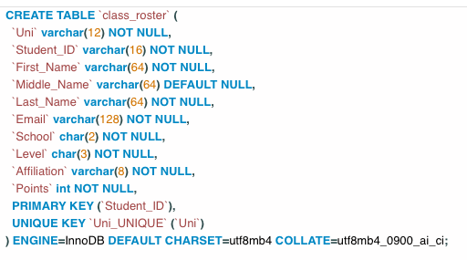
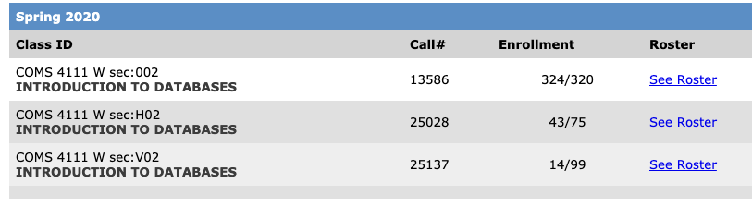
Views and Security
Views, which are a type of virtual tables allow users to do the following −
Structure data in a way that users or classes of users find natural or intuitive.
Restrict access to the data in such a way that a user can see and (sometimes) modify exactly what they need and no more.
Summarize data from various tables which can be used to generate reports. (https://www.tutorialspoint.com/sql/sql-using-views.htm)
An Example – Consider this Section
This is the table definition for the CSV roster that I can download.
60 | W4111_02_S20: Introduction to Databases -- Lecture 7

Slide 61
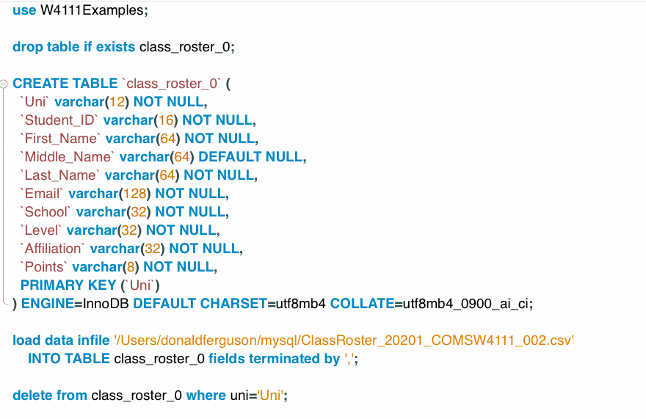
Loading Data (I)
There are command to LOAD and export data to/from files.
I am going to run the commands from an interactive shell.
Normal use is inside an SQL script.
There are also some security flags that I need to set.
I have to delete the header row.
61 | W4111_02_S20: Introduction to Databases -- Lecture 7

Slide 62
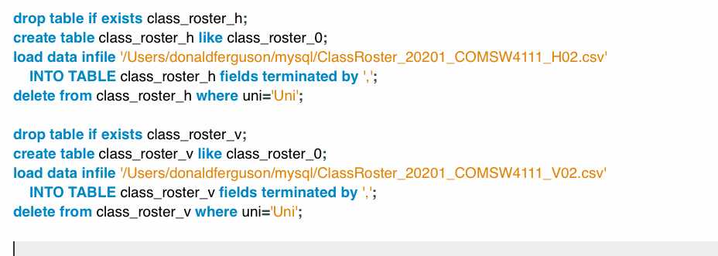
Loading Data (II)
I thought I could start loading into a new table and setting the section to ‘002’, ‘H02’, or ‘V02’ based on the table that I loaded.
Nope. One of you is in two sections, which messes up the student_id and ‘uni.’
There is one in every crowd!
62 | W4111_02_S20: Introduction to Databases -- Lecture 7

Slide 63
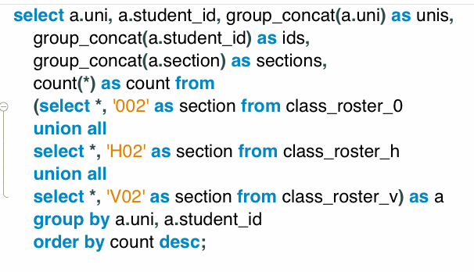
Loading Data (III) – How Did I Figure it Out?
After several failures, cursing, throwing my mouse. I ran the following query.
There is only one. Now, I must decide what to do. I decided to ignore the enrollment in the `H02` section and go with `002.`
63 | W4111_02_S20: Introduction to Databases -- Lecture 7

Slide 64
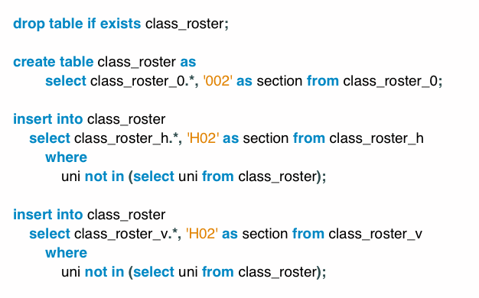
Loading Data (IV) – Load the Data Into Table
64 | W4111_02_S20: Introduction to Databases -- Lecture 7

Slide 65
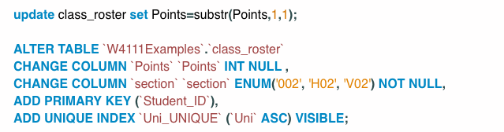
Loading Data (V) – Load the Data Into Table
Some schema/data cleanup!
65 | W4111_02_S20: Introduction to Databases -- Lecture 7

Slide 66
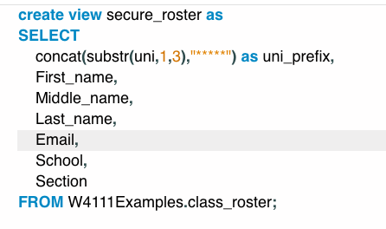
View and Security
Some of the fields are potentially sensitive, e.g.
UNI
student_id
I can create a view that “hides” these columns from non-root users.
Use GRANT/REVOKE to prevent access to underlying table.
66 | W4111_02_S20: Introduction to Databases -- Lecture 7

Slide 67
Some Miscellaneous Stuff
Relational Model
67 | W4111_02_S20: Introduction to Databases – Lecture 5

Slide 68
Set Comparison

Slide 69
Set Comparison – “some” Clause
Find names of instructors with salary greater than that of some (at least one) instructor in the Biology department.
Same query using > some clause
select distinct T.name
from instructor as T, instructor as S
where T.salary > S.salary and S.dept name = 'Biology';
select name
from instructor
where salary > some (select salary
from instructor
where dept name = 'Biology');

Slide 70
Definition of “some” Clause
F <comp> some r ⇔ ∃ t ∈ r such that (F <comp> t ) Where <comp> can be: <, ≤, >, =, ≠
0
(5 < some
5
) = true
(read: 5 < some tuple in the relation)
6
0
(5 < some
5
) = false
0
(5 = some
) = true
5
0
(5 ≠ some
5
) = true (since 0 ≠ 5)
(= some) ≡ in
However, (≠ some) ≡ not in

Slide 71
Set Comparison – “all” Clause
Find the names of all instructors whose salary is greater than the salary of all instructors in the Biology department.
select name
from instructor
where salary > all (select salary
from instructor
where dept name = 'Biology');

Slide 72
Definition of “all” Clause
F <comp> all r ⇔ ∀ t ∈ r (F <comp> t)
0
(5 < all
5
) = false
6
6
(5 < all
) = true
10
4
(5 = all
) = false
5
4
(5 ≠ all
) = true (since 5 ≠ 4 and 5 ≠ 6)
6
(≠ all) ≡ not in
However, (= all) ≡ in

Slide 73
Case Statement for Conditional Updates
Same query as before but with case statement
update instructor set salary = case when salary <= 100000 then salary * 1.05 else salary * 1.03 end

Slide 74
Test for Empty Relations
The exists construct returns the value true if the argument subquery is nonempty.
exists r ⇔ r ≠ Ø
not exists r ⇔ r = Ø

Slide 75
Accessing SQL From Programming Languages (Hands-on-Walthrough)
Relational Model
75 | W4111_02_S20: Introduction to Databases – Lecture 5

Slide 76
SQL Injection
Suppose query is constructed using
"select * from instructor where name = '" + name + "'"
Suppose the user, instead of entering a name, enters:
X' or 'Y' = 'Y
then the resulting statement becomes:
"select * from instructor where name = '" + "X' or 'Y' = 'Y" + "'"
which is:
select * from instructor where name = 'X' or 'Y' = 'Y'
User could have even used
X'; update instructor set salary = salary + 10000; --
Prepared stament internally uses: "select * from instructor where name = 'X\' or \'Y\' = \'Y'
Always use prepared statements, with user inputs as parameters

